Slide 1
Optimizing HPV Vaccination Coverage Through Targeted School Health Policies in the United States.
Presented by;
Miltone Awiti
Oscar Odera

Slide 2
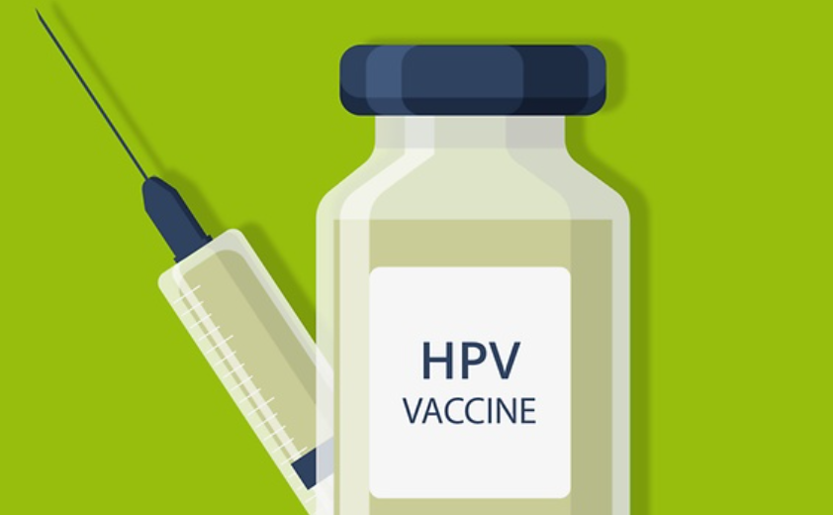
INTRODUCTION
The Human Papillomavirus (HPV) is the most predominant among sexually transmitted diseases, with serious implications for women's health worldwide.
Even with the availability of effective vaccines, the rate of HPV vaccination remains a challenge among young school-aged girls in the United States, pointing to the need for specialized and targeted public health strategies.
This study reviewed existing literature and found out that states with HPV school vaccination policies e.g. Rhode Island, Virginia and D.C have done considerably well in optimizing vaccination coverage with Rhode Island leading the park at 83% of adolescent girls having received HPV vaccines.
Notes:
HPV vaccination rates have consistently fallen behind those of other adolescent vaccines, exacerbated by disruptions in routine childhood vaccine delivery caused by the coronavirus disease pandemic. Efforts to bolster HPV vaccination coverage in schools have involved implementing evidence-based practices and interventions, including provider education, incentives, school outreach, and employing multidisciplinary approaches.
However, current interventions yield only marginal increases in vaccination coverage and necessitate frequent reinforcement. To address this challenge effectively, additional multi-faceted approaches pertaining to HPV vaccine access and uptake are necessary. Potential strategies encompass HPV vaccination mandates for school entry, expanding adolescent consent for vaccination, and facilitating pharmacist-administered vaccination.
For HPV-related policies to succeed, various conditions must be met, including adequate vaccine coverage and funding through programs like the Vaccines For Children (VFC) initiative, public acceptance of vaccine efficacy and safety, incorporation of the vaccine into immunization information systems, and endorsement from physicians/providers, alongside potential vaccine mandates.
Nonetheless, a comprehensive evaluation of vaccine mandates is crucial, considering diverse factors such as epidemiological, economic, and ethical considerations. Careful implementation is essential to prevent undermining support for immunization programs and to uphold the progress achieved through existing policies and initiatives.
https://www.immunizationmanagers.org/resources/aim-position-on-school-requirements/
https://www.health.ny.gov/prevention/immunization/providers/pharmacists_as_immunizers.htm

Slide 3
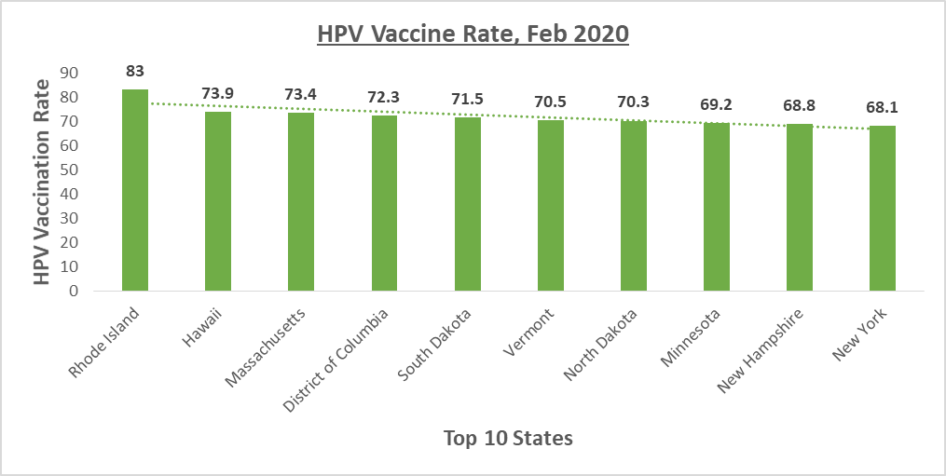
Source: Center for Health Law & Policy Innovation

Slide 4
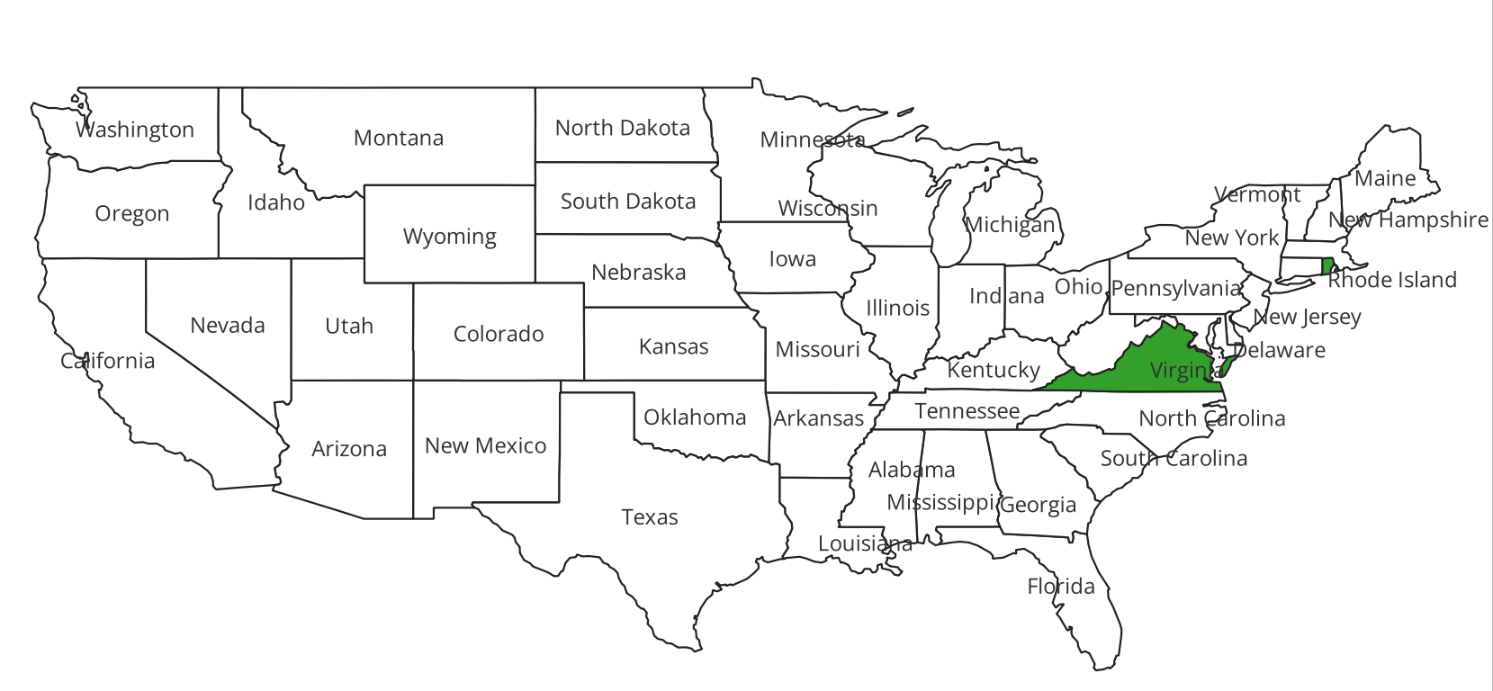


States With HPV Vaccination Requirements for Secondary Schools
March 2023
D.C
States with HPV Requirements for secondary Schools.

Slide 5
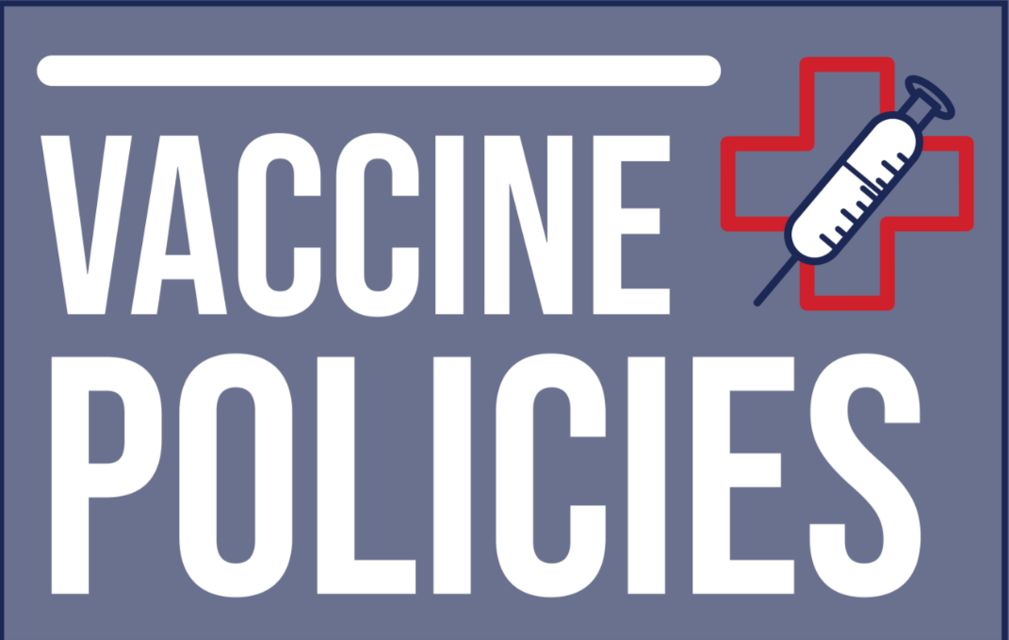
Impact to the Population/Public Health Field
Health Impact
Economic Impact
Educational Impact
Social Impact/Safety net
Equity Impact
Long-Term Impact
Notes:
1. Health Impact
Low HPV vaccination rates contribute to increased vulnerability to HPV-related diseases, including certain types of cancers. Improving vaccination coverage can significantly reduce the incidence of these diseases, leading to better health outcomes for the population.
2. Economic Impact
HPV-related diseases impose substantial economic burdens on healthcare systems and individuals. Increased vaccination coverage can alleviate some of these burdens by reducing the need for costly treatments and medical interventions associated with HPV-related conditions.
3. Educational Impact
Mandating HPV vaccination for school entry can ensure that adolescents receive necessary vaccinations, contributing to a healthier school environment. However, implementation may face resistance from certain segments of the population, necessitating education and outreach efforts to address concerns and promote acceptance.
4. Social Impact
Improved HPV vaccination rates can have broader social benefits by reducing the transmission of HPV infections within communities. This can contribute to overall public health and well-being by preventing the spread of infectious diseases.
5. Equity Impact
Efforts to increase HPV vaccination rates should also consider equity implications, ensuring that all segments of the population have access to vaccination services. Addressing barriers to vaccination, such as cost, accessibility, and awareness, can help reduce disparities in HPV-related disease burden among different demographic groups.
6. Long-Term Impact
By increasing HPV vaccination rates and implementing comprehensive strategies, such as vaccine mandates and provider education, the population can experience long-term benefits in terms of reduced HPV-related disease burden, improved public health outcomes, and potentially lower healthcare costs over time.

Slide 6
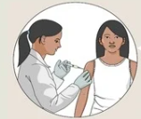
Challenges associated with the chosen research area topic
Parental Consent Requirements
Lack of Education and Awareness on the effects of HPV
Stigma and Misinformation
Vaccine inaccessibility and Inequity
Opt-out Provisions
Cultural and Barriers
Notes:
1. Parental Consent Requirements- Many states require parental consent for vaccination, which can be a barrier if parents are unaware of the importance of HPV vaccination or hold misconceptions about its safety and efficacy.
2. Lack of Education and Awareness- There may be a lack of education and awareness among parents, students, and even healthcare providers about the importance of HPV vaccination in preventing certain types of cancers.
3. Stigma and Misinformation- HPV vaccination has faced stigma and misinformation regarding its safety and association with sexual activity. Addressing these misconceptions is crucial in increasing vaccination rates.
4. Healthcare Access and Equity- Disparities in healthcare access and availability of vaccination services can lead to unequal vaccination rates across different demographic groups, exacerbating health inequities.
5. Cost and Insurance Coverage- Cost can be a barrier for some families, especially if they lack health insurance coverage or if their insurance does not fully cover the cost of vaccination.
6. Logistical Challenges- Implementing targeted vaccination programs in schools requires coordination among various stakeholders, including school administrators, healthcare providers, and public health agencies. Ensuring efficient delivery and tracking of vaccinations can be logistically complex.
7. Opt-out Provisions- Some states allow parents to opt their children out of school vaccination requirements for personal or philosophical reasons, which can undermine efforts to achieve high vaccination coverage rates.
8. Political and Legal Factors- Political and legal factors can influence the implementation of school vaccination policies, with debates over mandates, exemptions, and funding often shaping the landscape of vaccination programs.
9. Resistance from Anti-Vaccination Groups: Anti-vaccination groups may actively oppose efforts to increase HPV vaccination coverage, spreading misinformation and lobbying against vaccination policies.
10. Cultural and Language Barriers: Cultural beliefs and language barriers can impact the acceptance of vaccination recommendations within certain communities, necessitating culturally sensitive approaches to education and outreach.

Slide 7


Related work by others conducting research in this area
1. "Increasing HPV vaccination coverage through provider-based interventions" by Gilkey et al. This study explores the effectiveness of provider-based interventions, such as reminders and recalls, in improving HPV vaccination rates among adolescents. It compares different strategies and their impact on vaccination coverage.
2. "Implementing HPV vaccination policy in school-based health centers: A qualitative study" by Adams et al. This qualitative study investigates the implementation of HPV vaccination policies in school-based health centers. It explores challenges and facilitators to integrate HPV vaccination into routine healthcare services provided at schools.
3."The role of school-based health centers in promoting HPV vaccination: A systematic review" by Patel et al. This systematic review evaluates the effectiveness of school-based health centers in promoting HPV vaccination uptake. It synthesizes evidence from various studies to assess the impact of different interventions implemented in school settings.
Notes:
1. "Increasing HPV vaccination coverage through provider-based interventions" by Gilkey et al. This study explores the effectiveness of provider-based interventions, such as reminders and recalls, in improving HPV vaccination rates among adolescents. It compares different strategies and their impact on vaccination coverage.
2. "School-based health centers as medical homes and their impact on racial and ethnic disparities in the United States" by Brindis et al. This paper examines the role of school-based health centers (SBHCs) in providing comprehensive healthcare, including HPV vaccination, to underserved populations. It discusses the potential of SBHCs in reducing disparities in vaccination coverage.
3. "Implementing HPV vaccination policy in school-based health centers: A qualitative study" by Adams et al. This qualitative study investigates the implementation of HPV vaccination policies in school-based health centers. It explores challenges and facilitators to integrate HPV vaccination into routine healthcare services provided at schools.
4."The role of school-based health centers in promoting HPV vaccination: A systematic review" by Patel et al. This systematic review evaluates the effectiveness of school-based health centers in promoting HPV vaccination uptake. It synthesizes evidence from various studies to assess the impact of different interventions implemented in school settings.
5. "Using GIS mapping to target public health interventions: Examining disparities in HPV vaccination coverage among adolescents in the United States" by Smith et al. This study utilizes Geographic Information Systems (GIS) mapping to identify geographical areas with low HPV vaccination coverage among adolescents. It highlights the potential of targeted interventions in addressing disparities in vaccination uptake.

Slide 8

Opportunities for new areas of research
Policy Evaluation
Addressing vaccine inequity
School Based Health Centers
Parent and Community Engagement
Long Term impacts
Notes:
Policy Evaluation: There's an opportunity to evaluate existing school health policies related to HPV vaccination and assess their effectiveness. This evaluation can identify gaps in policy implementation, barriers to vaccination, and areas for improvement.
Intervention Development: Researchers can develop targeted interventions aimed at increasing HPV vaccination coverage in school settings. These interventions could include educational campaigns, provider training programs, and innovative approaches to vaccine delivery.
Partnerships and Collaboration: Collaboration between schools, healthcare providers, public health agencies, and community organizations can enhance efforts to optimize HPV vaccination coverage. Building partnerships can lead to coordinated strategies, resource sharing, and increased access to vaccination services.
Technology Integration: Leveraging technology, such as mobile apps, telemedicine, and electronic health records, can improve communication, streamline vaccine delivery, and facilitate tracking of vaccination rates. There's an opportunity to explore how technology can be integrated into school health policies to enhance HPV vaccination efforts.
Addressing Equity: Research can focus on addressing disparities in HPV vaccination coverage among different demographic groups, including racial/ethnic minorities, low-income populations, and rural communities. Understanding the underlying factors contributing to these disparities and developing targeted interventions to address them is crucial.
School-Based Health Centers (SBHCs): SBHCs play a vital role in providing healthcare services to students, including HPV vaccination. There's an opportunity to strengthen the capacity of SBHCs to deliver HPV vaccines effectively, improve access to care, and integrate vaccination efforts into broader school health initiatives.
Parent and Community Engagement: Engaging parents, caregivers, and community members is essential for increasing HPV vaccination acceptance and uptake. Research can explore effective strategies for engaging these stakeholders, addressing concerns and misconceptions, and promoting vaccine acceptance within communities.
Health Education Programs: Developing and implementing comprehensive health education programs in schools can increase awareness about HPV, the importance of vaccination, and cancer prevention. These programs can empower students to make informed decisions about their health and encourage vaccination uptake.
Evaluation of Cost-Effectiveness: Assessing the cost-effectiveness of targeted school health policies for HPV vaccination can provide valuable insights for policymakers and healthcare providers. Understanding the economic impact of different interventions can inform resource allocation and decision-making.
Long-Term Impact: Research can explore the long-term impact of HPV vaccination efforts initiated in school settings, including reductions in HPV-related diseases such as cervical cancer, genital warts, and oropharyngeal cancers. Longitudinal studies can assess the sustained effectiveness of vaccination programs and inform future strategies

Slide 9

Enactment of a nationwide policy that mandates schools to have HPV vaccination requirement during admission.
The Federal government should allocate a substantial amount of funding to facilitate HPV vaccine manufacturing and distribution to schools.
Conducting campaigns targeted at students, parents and educator to increase awareness of the impacts of HPV vaccination and addressing myths and misconceptions about the vaccine.

Slide 10
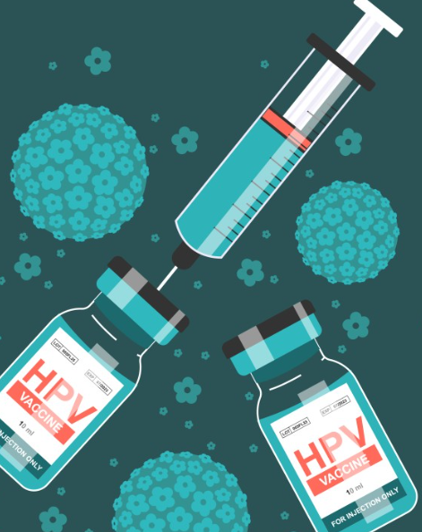
Overall assessment and conclusion of this topic
Targeted school health policies can greatly improve HPV vaccination rates among adolescents and young adults. These policies can influence the uptake of vaccines and help avert HPV-related diseases by overcoming hindrances to access and incorporating the school system's infrastructure. However, continuous studies and collaborations are essential to guarantee that these efforts are effectively promoting population health and are decreasing the impact of HPV infection and related diseases.

Slide 11
REFERENCES
https://www.health.ny.gov/prevention/immunization/providers/pharmacists_as_immunizers.htm
https://www.health.ny.gov/prevention/immunization/providers/pharmacists_as_immunizers.htm
https://www.ncbi.nlm.nih.gov/pmc/articles/PMC10478734/
https://pubmed.ncbi.nlm.nih.gov/31654772/
https://www.ncbi.nlm.nih.gov/pmc/articles/PMC2556726/
https://link.springer.com/article/10.1007/s40272-016-0177-1
https://journals.sagepub.com/doi/full/10.1177/0033354918793629
https://publications.aap.org/pediatrics/article-abstract/138/1/e20153863/52510/Interventions-to-Improve-HPV-Vaccine-Uptake-A
Notes:
https://www.immunizationmanagers.org/resources/aim-position-on-school-requirements/

Slide 12
Thank you

